Slide 1
Digital Portfolio
STUDENT NAME : KIRUTHIKA V
REGISTER NO AND NMID : 24132061802522037
DEPARTMENT : B.SC COMPUTER SCIENCE
COLLEGE :THIRU A GOVINDASAMY GOVERNMENT
ARTS COLLEGE/ANNAMALAI UNIVERSITY

Slide 2
PROJECT TITLE
CREATIVE STUDENT PORTFOLIO
USING FWD

Slide 3


AGENDA
Problem Statement
Project Overview
End Users
Tools and Technologies
Portfolio design and Layout
Features and Functionality
Results and Screenshots
Conclusion
Github Link
3/21/2024 Annual Review

Slide 4

PROBLEM STATEMENT
Students often lack a structured and professional way to showcase their skills, projects, and achievements online.
Traditional resumes are static and do not highlight creativity or practical work effectively.
There is a need for a personalized, accessible, and interactive digital portfolio that reflects a student’s profile, skills, and projects.

Slide 5

PROJECT OVERVIEW
About Me – Introduction, education, and hobbies.
Skills – Technical and soft skills represented using progress bars or cards.
Projects – A showcase of academic and personal projects with descriptions.
Contact – A form to connect with the student easily.

Slide 6

WHO ARE THE END USERS?
Recruiters / Employer’s
To evaluate the student’s skills, projects, and achievements for internships or jobs.
Teachers / Mentors
To assest the student’s learning progress, academic work, and creativity.
Peers / Classmates
To collaborate, get inspiration, and share knowledge.
The Student Themselves
To track personal growth, showcase abilities, and build confidence.

Slide 7

TOOLS AND TECHNIQUES
Design: Canva, Figma, Adobe XD
Coding: HTML, CSS, JavaScript, React
Docs & Presentation: MS Word, PowerPoint, Google Slides
Version Control: GitHub
Techniques: Clear layout, consistent style, visuals, highlight best projects, storytelling (Problem → Solution → Result).

Slide 8
POTFOLIO DESIGN AND LAYOUT
Cover Page – Title, Name, College, Course
About Me – Short bio + career objective
Problem Statement – 2–3 key points
Project Overview – Aim, objectives, tools used
Design & Features – Flow, key functions, layout/screens
Results – Outputs & outcomes
Conclusion – Summary & future scope
8

Slide 9
FEATURES AND FUNCTIONALITY
Personal info & career objective
Skills & tools used
Project showcase with outcomes
Achievements & certifications
Contact details

Slide 10
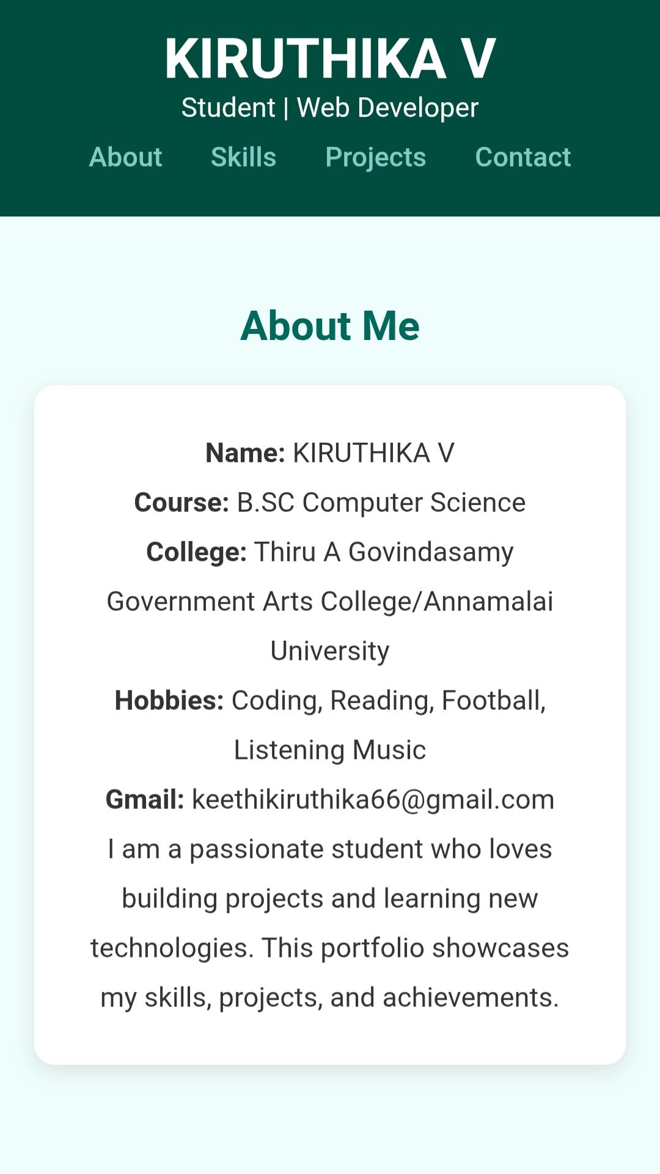
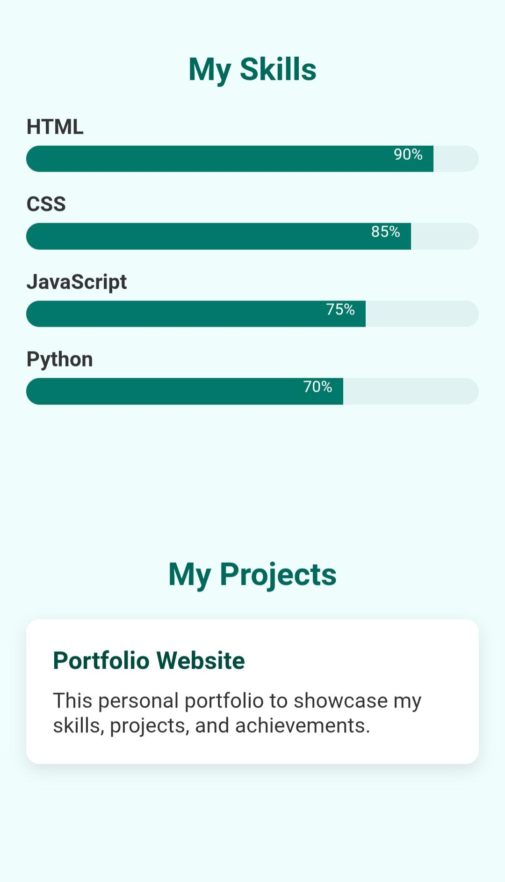
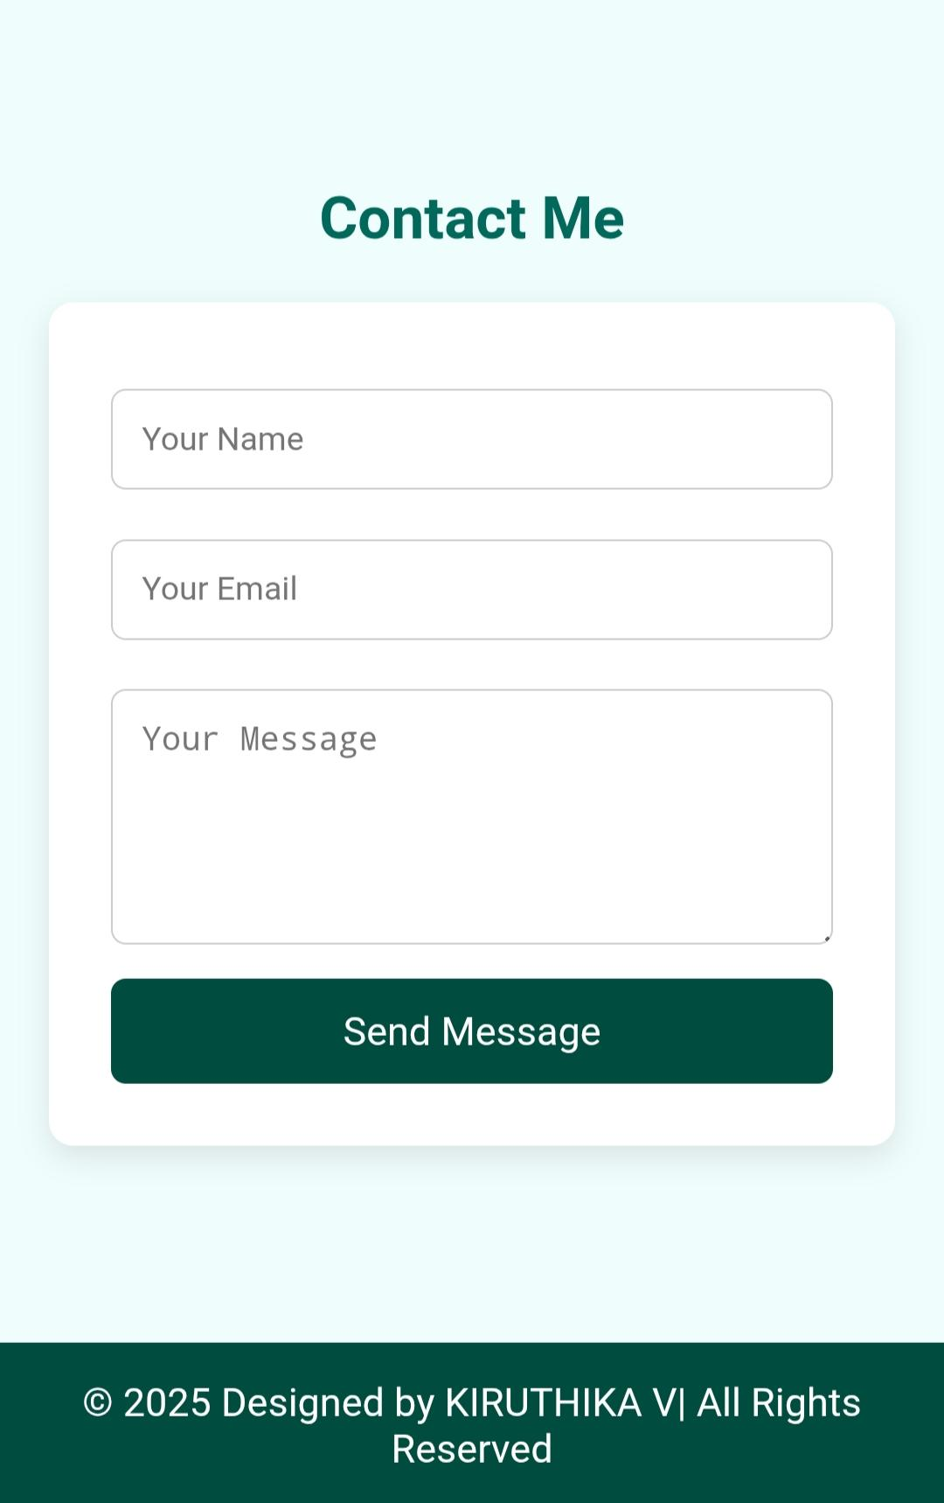

RESULTS AND SCREENSHOTS
3/21/2024 Annual Review
10

Slide 11
CONCLUSION
This portfolio highlights my skills, projects, and achievements, reflecting my learning journey and growth. It demonstrates my ability to apply knowledge, solve problems, and work on real-world projects, while also showing my commitment to continuous improvement and future opportunities.
11

